Slide 1

EFRA: a plan to restructure education funding
introduction
Senate Select Committee On K-12 Funding
December 15, 2010

Slide 2
current funding system is a big mess!
why restructure?
»
»
»
»
»
»
»
complicated
confusing
opaque
unbalanced
internally inconsistent
arbitrary
annual patchwork of provisos, special legislation, conflicting statutes and non-formula funding

Slide 3
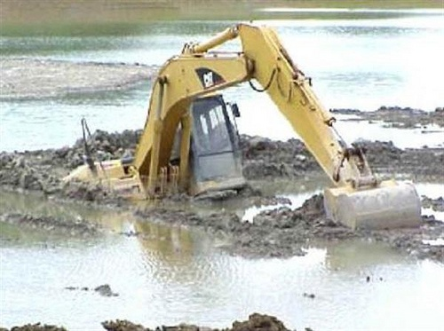

Slide 4
property tax system is in a shrinking straightjacket
why restructure?
limits on increases in value: 15% reassessment cap … examples:
»
»
Richland One - $1 billion in FMV lost = $6.4 million annual operating funds
Berkeley - $600 million in FMV lost = $3.4 million annual operating funds

Slide 5
property tax system is in a shrinking straightjacket
more exemptions, especially homestead and multi-county parks… examples:
why restructure?
»
»
statewide homestead in 2008-2009 = $163 billion in FMV lost ($6.5 billion in assessed value)
multi-county parks: Berkeley – 100% property tax credit for 15 years on a new investment

Slide 6
property tax system is in a shrinking straightjacket
why restructure?
homestead reimbursements limited at amounts less than what taxes would be:
»
»
(homestead value x operating rate) – reimbursements (tiers 1, 2 & 3) = $63 million loss in 2008-2009 (2nd year of Act 388)

Slide 7
property tax system is in a shrinking straightjacket
property tax millage rates limited to CPI plus all-age population growth
why restructure?
»
»
»
if you don't use it, you lose it
population estimates were too low
no adjustment for loss of state revenue or state-required increases in cost

Slide 8
property tax system is in a shrinking straightjacket
why restructure?
school operating revenue used for county purposes through multi-county park scheme
»
example: Berkeley – in one year, the school district's portion of fee-in-lieu-of-taxes of $1.8 million used to pay county water and sewer obligations while the school district got zero

Slide 9
property tax system is in a shrinking straightjacket
value of property within districts is the main factor in distributing state revenue under the Education Finance Act (EFA), so that all of the distortions in the property tax system distort the distribution of state revenue
the limitations on local property taxes mean districts cannot generate local revenue to meet the local share of funding required under the EFA or compensate for a loss of state revenue
since the state tax structure does not produce enough revenue to pay the costs of economic development, school districts (through the fee/multi-county park scheme) are a prime source of funding
why restructure?

Slide 10
funding plan working group
»
»
»
»
»
finance officers from 16 S.C. school districts
SCSBA staff
SCASA staff
Childs & Halligan
Miley & Associates, Inc.
the funding plan

Slide 11


Slide 12
objectives met: funding plan like no other
radical simplification of education funding and taxation
abolishes index of taxpaying ability
abolishes EIA minimum effort
flattens school operating millage rates
eliminates conflicts between property tax limits and funding requirements
eliminates gap between homestead operating taxes and reimbursement
abolishes tiers and mishmash of CPI/population growth formulas
reduces use of "parallel" tax system for FILOTs/multi-county parks
the funding plan

Slide 13
objectives met: funding plan like no other
Sustainable, stable plan over time
increases revenue for 60% of SC students…hurts no students
provides businesses tax relief to encourage economic growth
reduces risk of property tax erosion
provides fiscal base to repair state teachers salary schedule
local funding flexibility for boards and communities
addresses state aid for school construction
the funding plan

Slide 14
data collected and adjustments
2008-2009 fiscal year and 2008 tax year
weighted pupil units (WPU) developed by the Education Oversight Committee (EOC)
revenue, not expenditure or cost
reduced 2008-2009 “state rollup" by 15% to make estimate closer to 2010-11 fiscal year
the funding plan

Slide 15
estimated total revenue to fund state education funding program
the funding plan

Slide 16
base student funding (BSF)
the funding plan
$4,787,044,809 ÷ 920,609 = $5,200 per EOC WPU
the methodology starts by treating all students the same wherever they are, as if the state was one district

Slide 17
EFRA is a package deal!
Each of the plan’s components is interrelated and must be enacted in total.
the funding plan

Slide 18
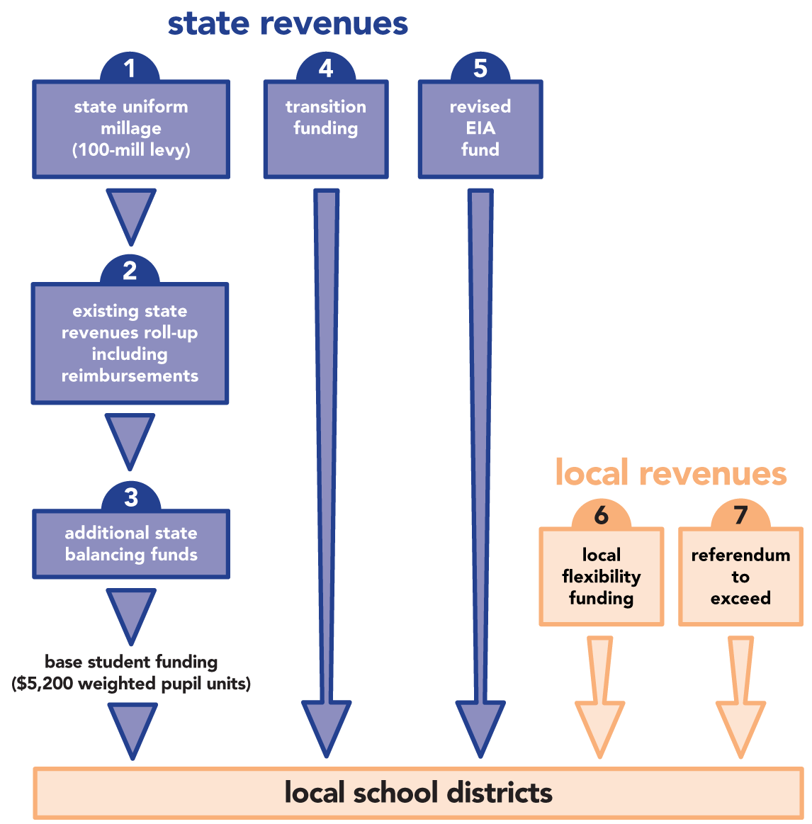

Slide 19
how to “restructure” the funding?
the funding plan

Slide 20
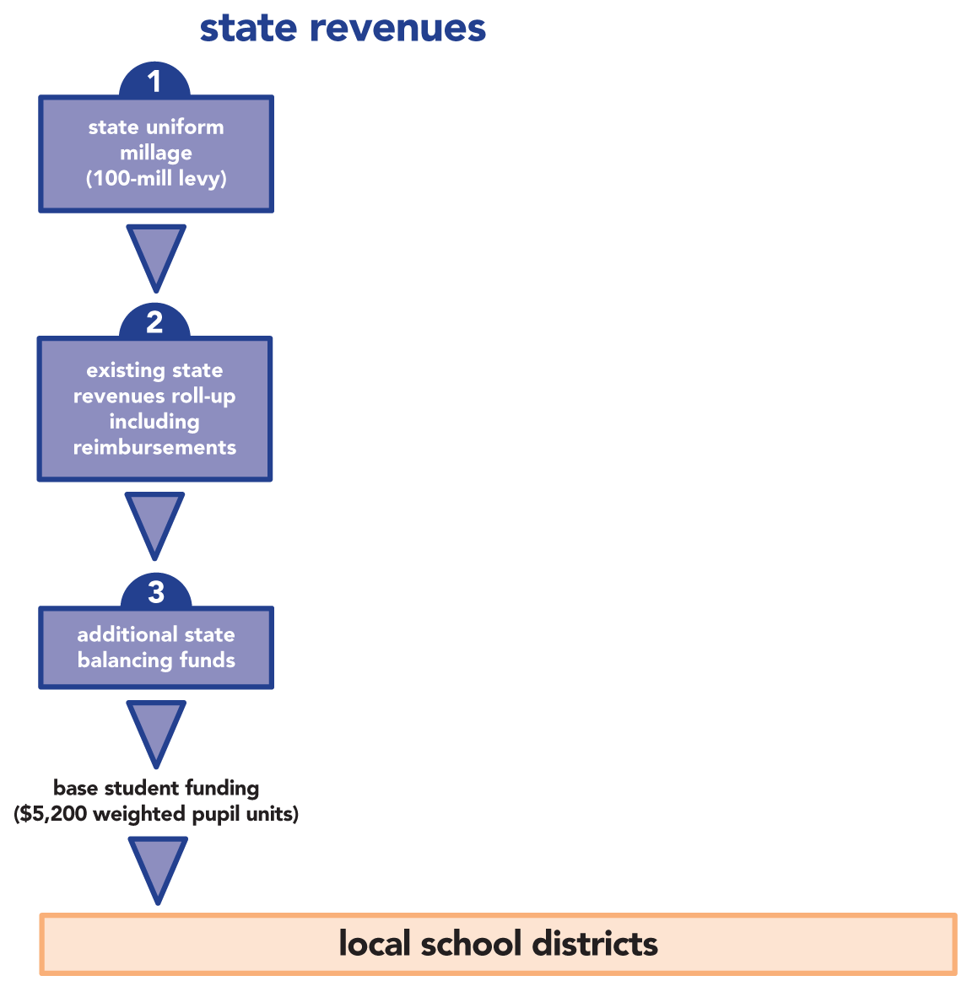
$ 1,286,945,887
$ 97,492,195 FILOT (‘09 revenues)
$ 1,941,735,448 state rollup (85% 09 revenues)
$ 919,077,847 tiers 1,2,3 (‘09 revenues)
$ 46,071,942 other reimbursements (‘09 revenues)
$ 3,004,377,432 subtotal
$ 495,721,490
$ 4,787,044,809 (est. 2010-11 revenues) Total

Slide 21
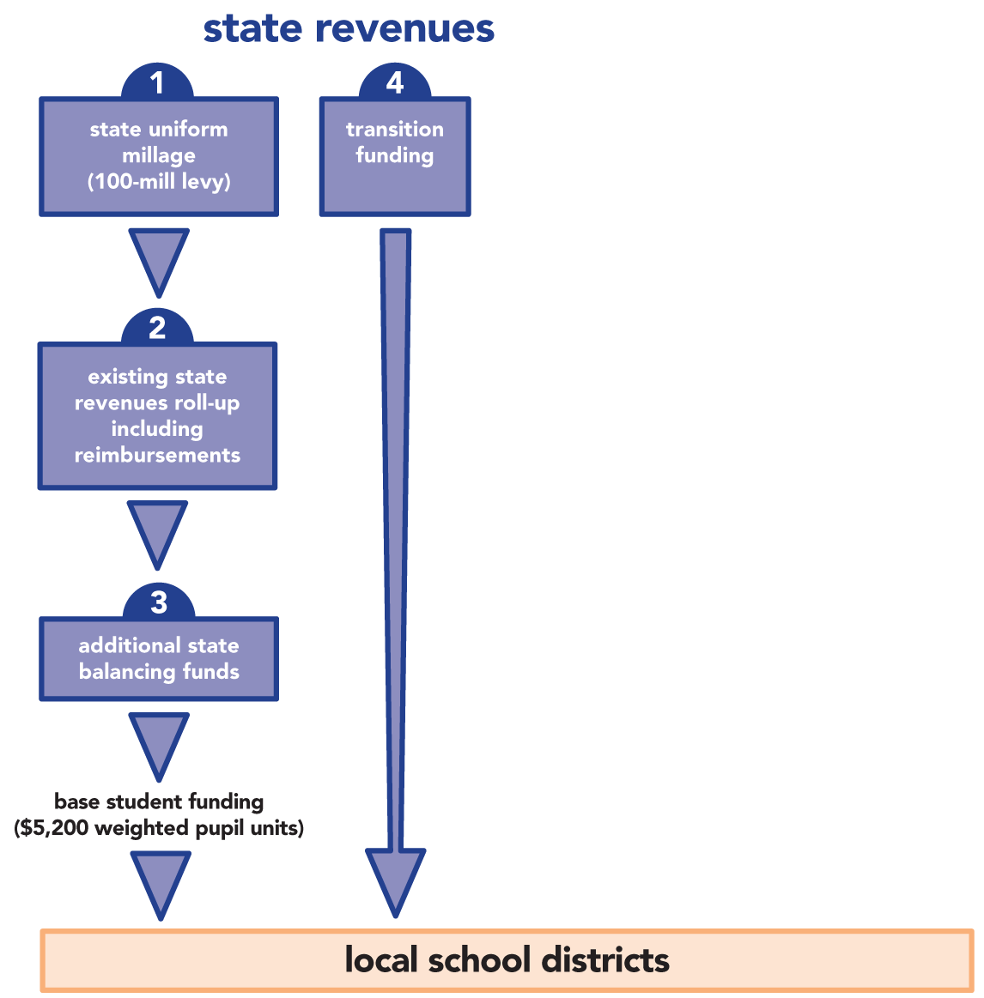
$341,768,343

Slide 22
additional state balancing funds $ 495,721,490
transition funding $ 341,768,343
total funds needed $ 837,538,898*
to provide tax relief - $ 513,294,396
difference $ 324,244,502
*update estimates using 2009 tax year and FY2009-10 audited data
*develop and evaluate use of multi-year, phase-in options

Slide 23
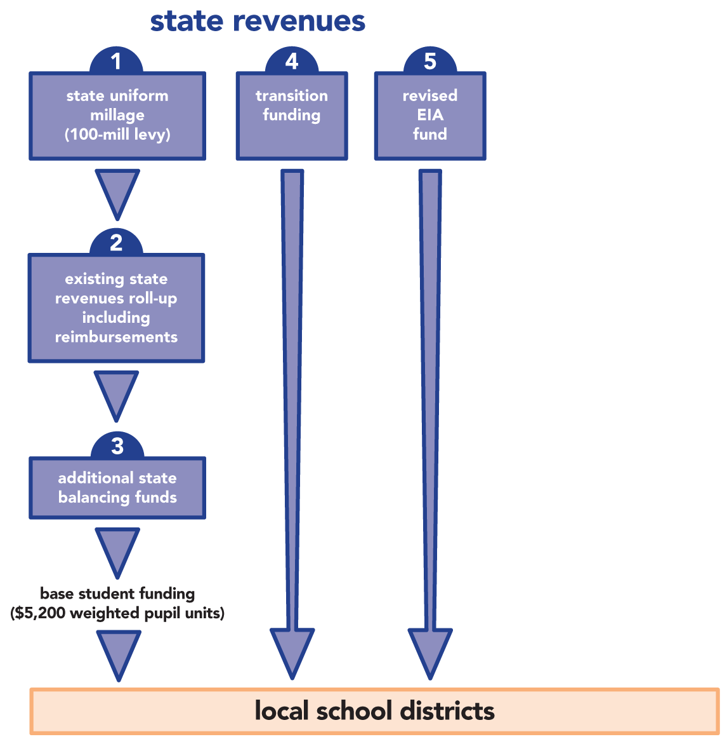
categorical programs not distributed on per pupil basis:
transportation related
national board certification
palmetto priority schools
retiree insurance
4K programs

Slide 25
annual base student funding adjustment
the funding plan
»
»
use current EFA inflation factor: 88% compensation survey and 12% CPI
BSF adjustment by law must include the entire increase for salaries, medical benefits, retirement and other personnel cost increases, and any other state-required cost increase

Slide 26
two forms of local flexibility funding
local funding
»
»
district school board authority to levy property taxes up to 8% of the assessed value of taxable property (same as 8% constitutional debt limit) but not including homestead (4%) property, for operations
by popular referendum, the voters may approve additional operational funding and the property tax rate approved by the referendum would apply to homestead (4%) property (same as a referendum under the constitutional debt section)

Slide 27
local flexibility funding and fees/multi-county parks
local funding
property taxes levied under local flexibility funding will apply to new FILOT agreements or amendments within all multi-county parks for millage in excess of 100 mills, subject to restrictions on county authority to grant credits and to divert revenue derived from the school districts' local flexibility tax rate (board and referendum)

Slide 28
state uniform millage (“sum”)
1.
2.
3.
4.
the state of South Carolina levies SUM of 100 mills
100-mill levy applies statewide to all taxable property, not including homestead (4%) but including future property subject to FILOT agreements and/or contained within multi-county industrial or business parks (existing agreements would not be affected)
100-mill levy is not subject to roll back/up millage adjustment after reassessment
the revenue estimated from 100 mills must be reduced by a factor for uncollected taxes. However, the collection factor should be the subject of annual analysis based on a moving average over a reasonable period of years
the funding plan

Slide 29
state uniform millage (“sum”) (continued)
5.
100-mill levy is levied on all property subject to FILOT agreements and/or within all multi-county parks
the funding plan
100-mill levy is not subject to county reallocation of revenue or special source revenue bonds or credits of any kind
All current FILOT/multi-purpose parks revenue is included within the SUM, regardless of the actual millage used in the FILOT agreement

Slide 30
state uniform millage (“sum”) (continued)
6.
SUM will be collected by state and placed in a separate restricted state fund distinct from the state general fund: “state education program fund"
the funding plan

Slide 31
other issues
multi-district or county-based sharing arrangements (such as in Anderson, Marion, Orangeburg, Spartanburg and York) will be unnecessary and will be eliminated as to the base student funding. For the relatively few districts affected, such multi-district arrangements may have a role in the local board and referendum flexibility funding, after careful thought and planning
the restructuring plan will not affect millage and funding for multi-district vocational schools, alternative schools, schools for the disabled, etc., or non-district county boards
the assessment ratio for manufacturing property will be reduced from 10.5% to 6%
other issues

Slide 32
other issues (continued)
other issues
all sources of revenue for the State Education Funding Program, including Transition Funding, will be collected within the separate, restricted State Education Program Fund
a reserve fund within the State Education Program Fund of 5% will be established over a multi-year period, at a rate of 1/2% per year
categorical funding will be placed within a revised EIA Fund
all districts will be authorized to maintain fiscal year-end unassigned general fund balances of not less than 15% and not more than 30%, consistent with new accounting rules

Slide 33
other issues (continued)
property taxes levied under local flexibility funding will apply to new FILOT agreements or amendments within all multi-county parks for millage in excess of 100 mills, subject to restrictions on county authority to grant credits and to divert revenue derived from the school districts' local flexibility tax rate (board and referendum)
EFRA will include the School Facilities Infrastructure Act previously proposed
EFRA creates an education finance review committee to report every five years to the general assembly with an analysis and evaluation of the finance program, with recommendations for change to help check the tendency to make inconsistent changes over the years and correct imbalances and distortions
other issues

Slide 34

spreadsheets

Slide 35
next steps
update data using 2009-10 audited data, compare closely to the 2010-11 budget, and prepare projections for future years
after evaluation and criticism, revise the plan to make it better
next steps

